Slide 1

Birdseye
Aaditya Sharma, Adam Eshaq, Bryce Pollak, Tamir Zharmagambetov

Slide 2
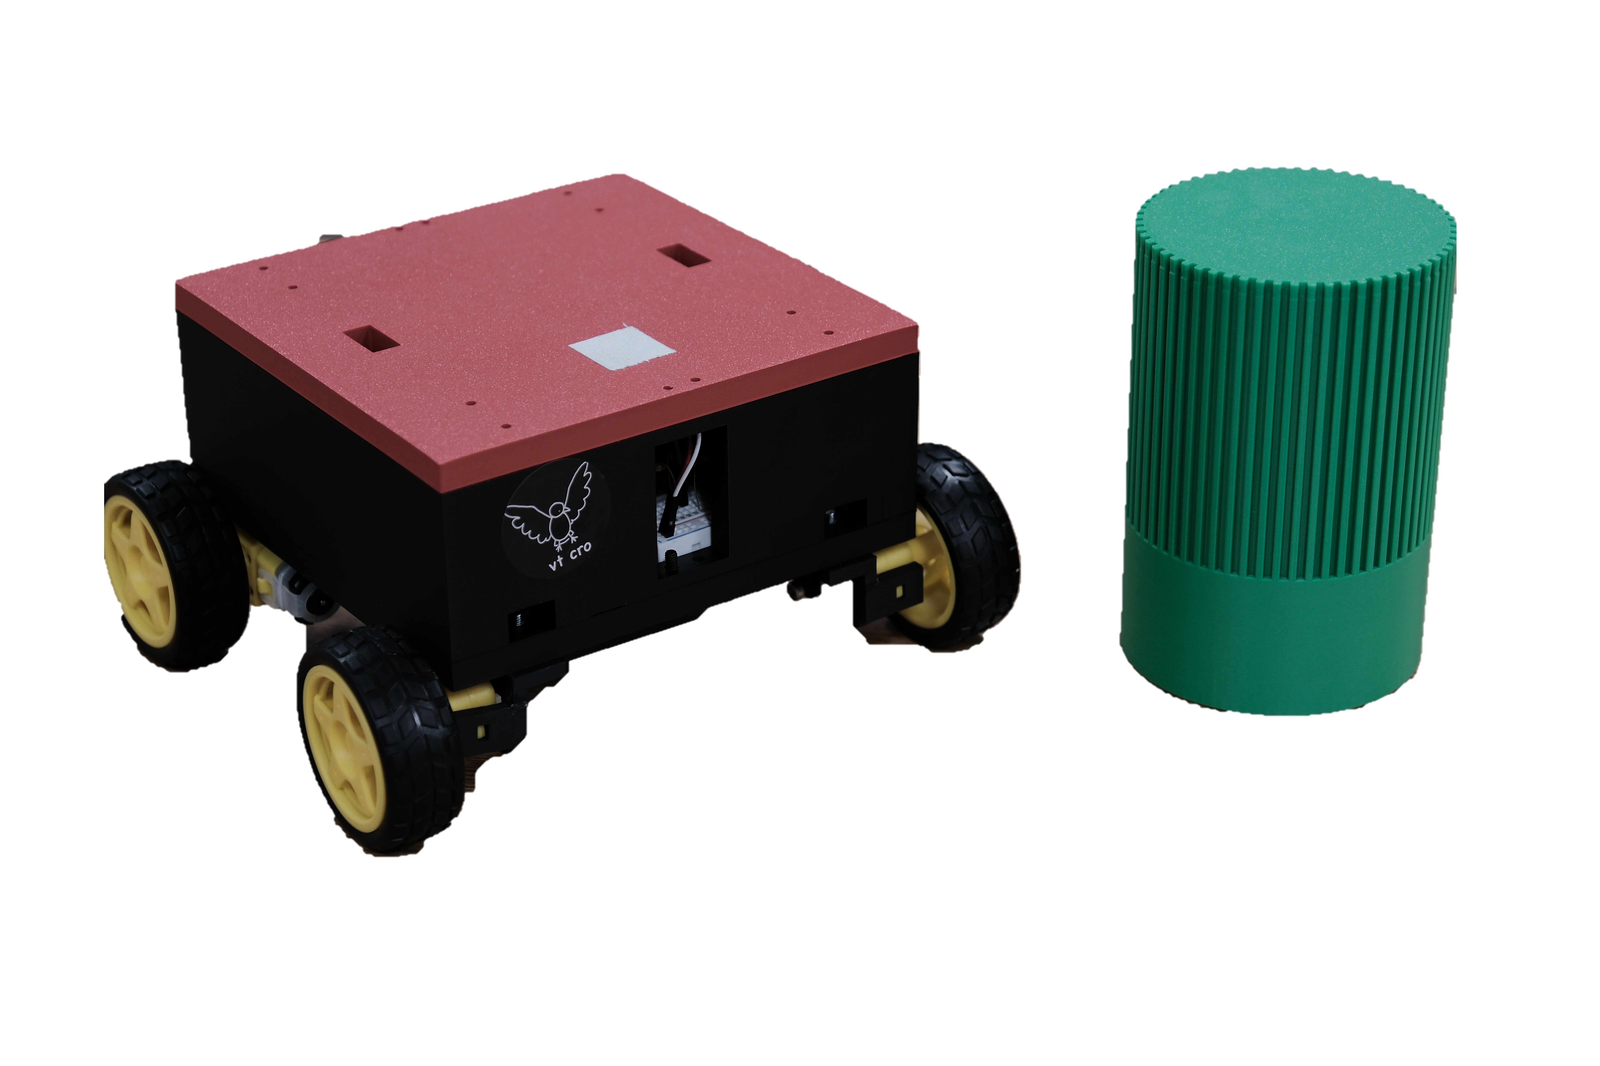
Birdseye
Dynamic Vision-Based Autonomous Rover Path Planning and Navigation in Real Time
Aaditya Sharma – Algorithm Development
Adam Eshaq – Hardware / Software Integration
Bryce Pollak – Algorithm Development
Tamir Zharmagambetov – Algorithm Development

Slide 3
“All models are wrong, but some are useful”
- George box

Slide 4
Motivation and problem statement
PROBLEM
Autonomous overhead-camera navigation: drive a small RC car from a top-down view to a colored target on a fixed field, using vision + a learned policy + Bluetooth commands.
APPLICATION BASED
Applications in factory, manufacturing, construction, and defense settings
REAL WORLD
Challenge to make a model perform well in both simulation and transfer that performance to the real world
ROBOTICS AND TESTING
Relevant to robotics, embedded AI, and extensively tested in various real-world conditions

Slide 5
APPROACH AND METHODOLOGY
HIGH LEVEL FLOW
SIMULATOR
RL WRAPPER
top-down car, discrete actions (forward / back / rotate L / rotate R / stop), collisions, random target placement
same 22-d state as runtime, shaped rewards (progress + bonuses/penalties)
TRAIN DOUBLE DQN
DEPLOY
replay buffer, target network, ε-greedy exploration, GPU when available
webcam → HSV / color detectors for car + target → assemble vector → greedy DQN → serial motor strings

Slide 6
APPROACH AND METHODOLOGY
DATASTET AND TOOLS USED
DYNAMIC
CALIBRATION
Not a static dataset, virtual experience from the simulator (millions of transitions)
Calibration runs on the real rig - footprint, forward/backward speeds, CCW vs CW turn rates in the same 900×600 frame the policy uses
ALGORITHMS
Deep Q-Network (Double DQN-style targets)
PyTorch - Model
Pygame – Simulation
OpenCV - Detection
Pyserial - Bluetooth

Slide 7
CHALLENGES OVERCOME
Decision-rate mismatch
Asymmetric hardware
Geometry mismatch
Real commands held ~1/15 s per tick vs sim step that was effectively shorter — caused 3–4× overshoot in effect per action
Different forward vs backward and CCW vs CW rotation rates; old sim assumed symmetry — fixed with per-action speeds from calibration
Real car footprint closer to square vs long rectangle in sim

Slide 8
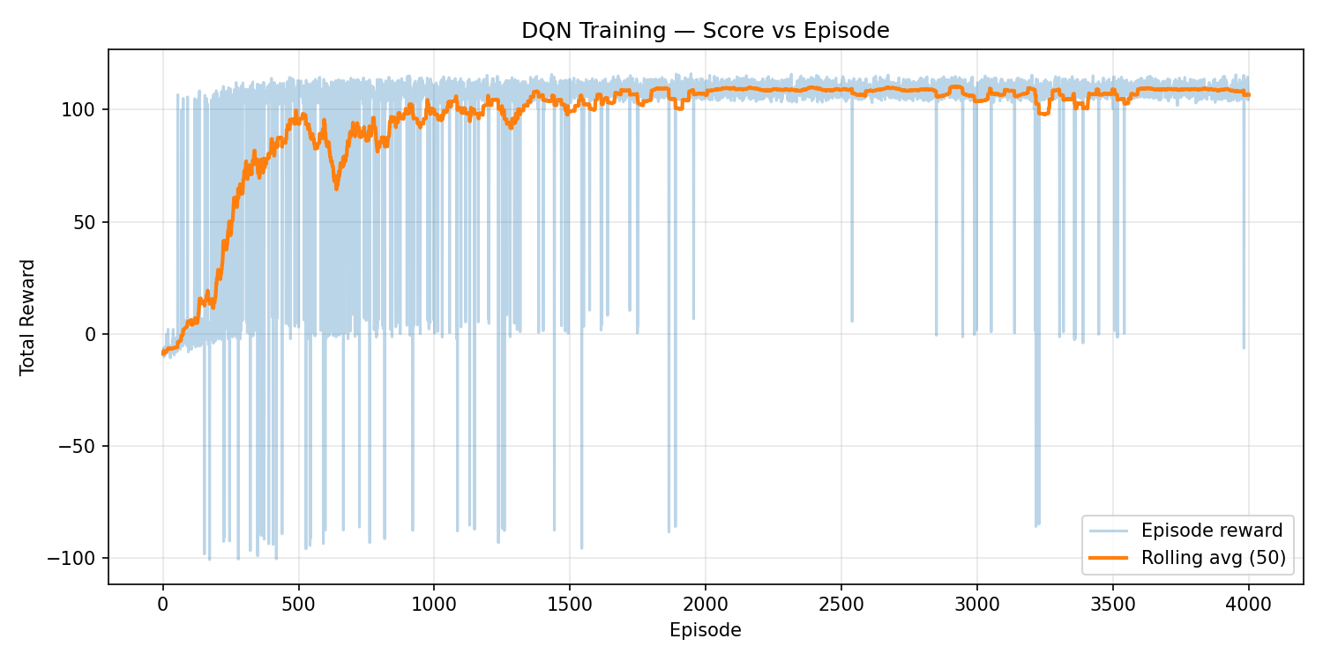
RESULTS AND KEY FINDINGS
INTRODUCING IMPERFECTION
Adding variance and randomness to simulation rig led to a significantly more robust model
Simulation mismatch
Calibration in line with real world settings led to qualitative improvement
Transition model
Same function approximator with an improved transition model causes more effective sim to real-world

Slide 9
Conclusion + demo
ACHIEVEMENTS
Vision → State Generation → DQN → Action
Robust sim + real-world model, ~95% success rate
Future Work
Obstacles Detection + Avoidance
HSV → YOLO for Object Detection

